Slide 1
Information Technology Services
Student Induction

Slide 2
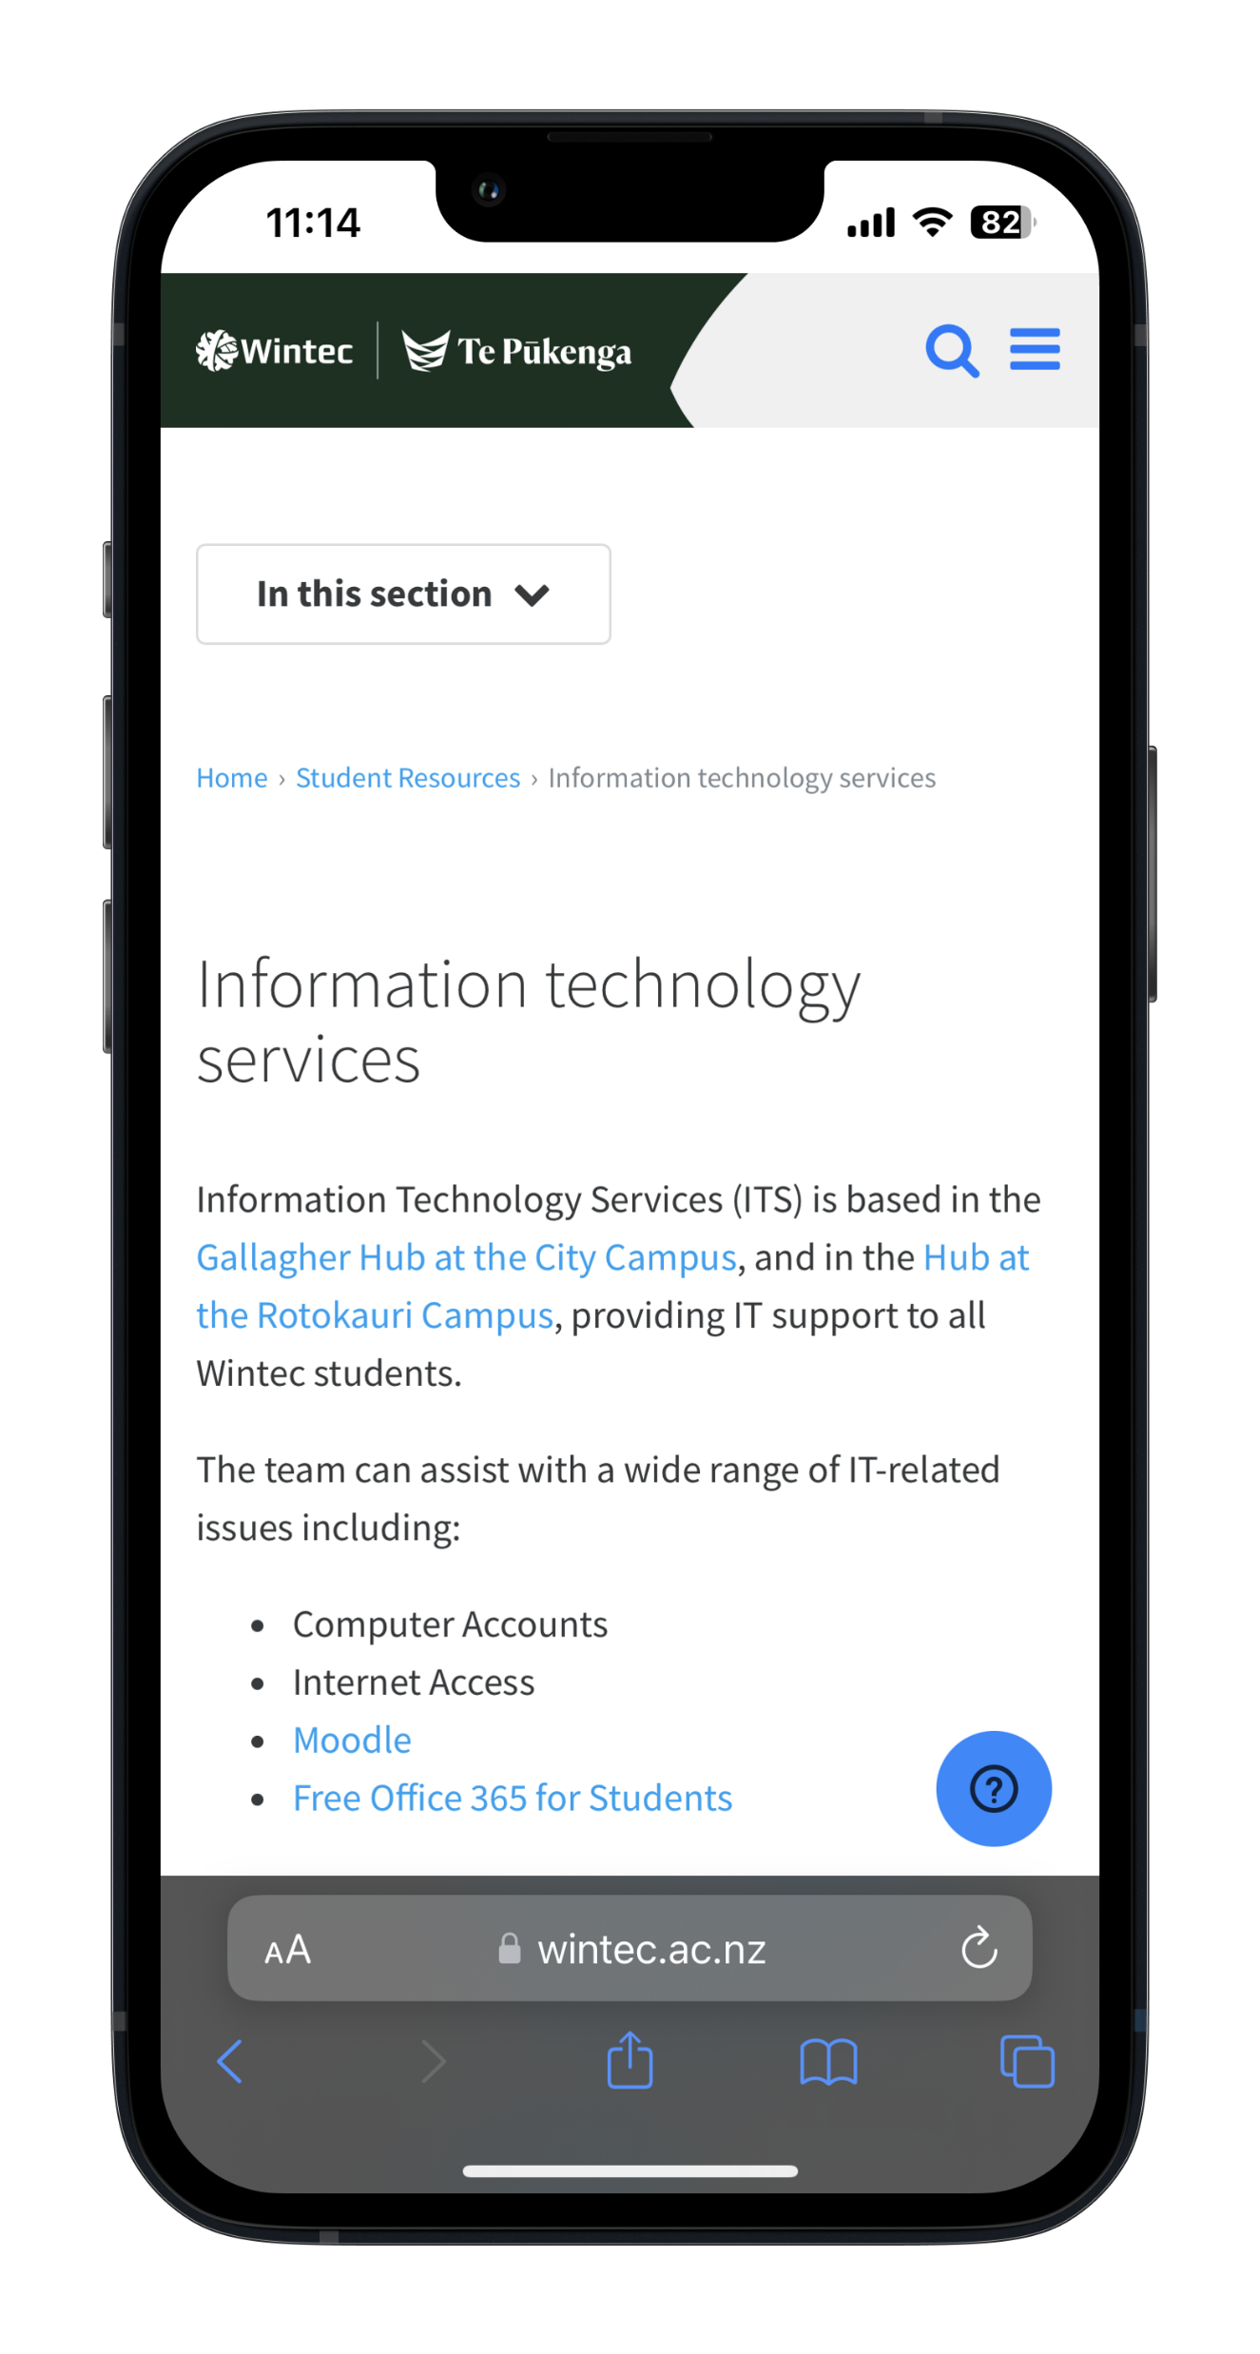
Things to know
Where to find us
Support Centre
Wintec Accounts
Free Office 365 Apps
Printing
Student Laptops

Slide 3
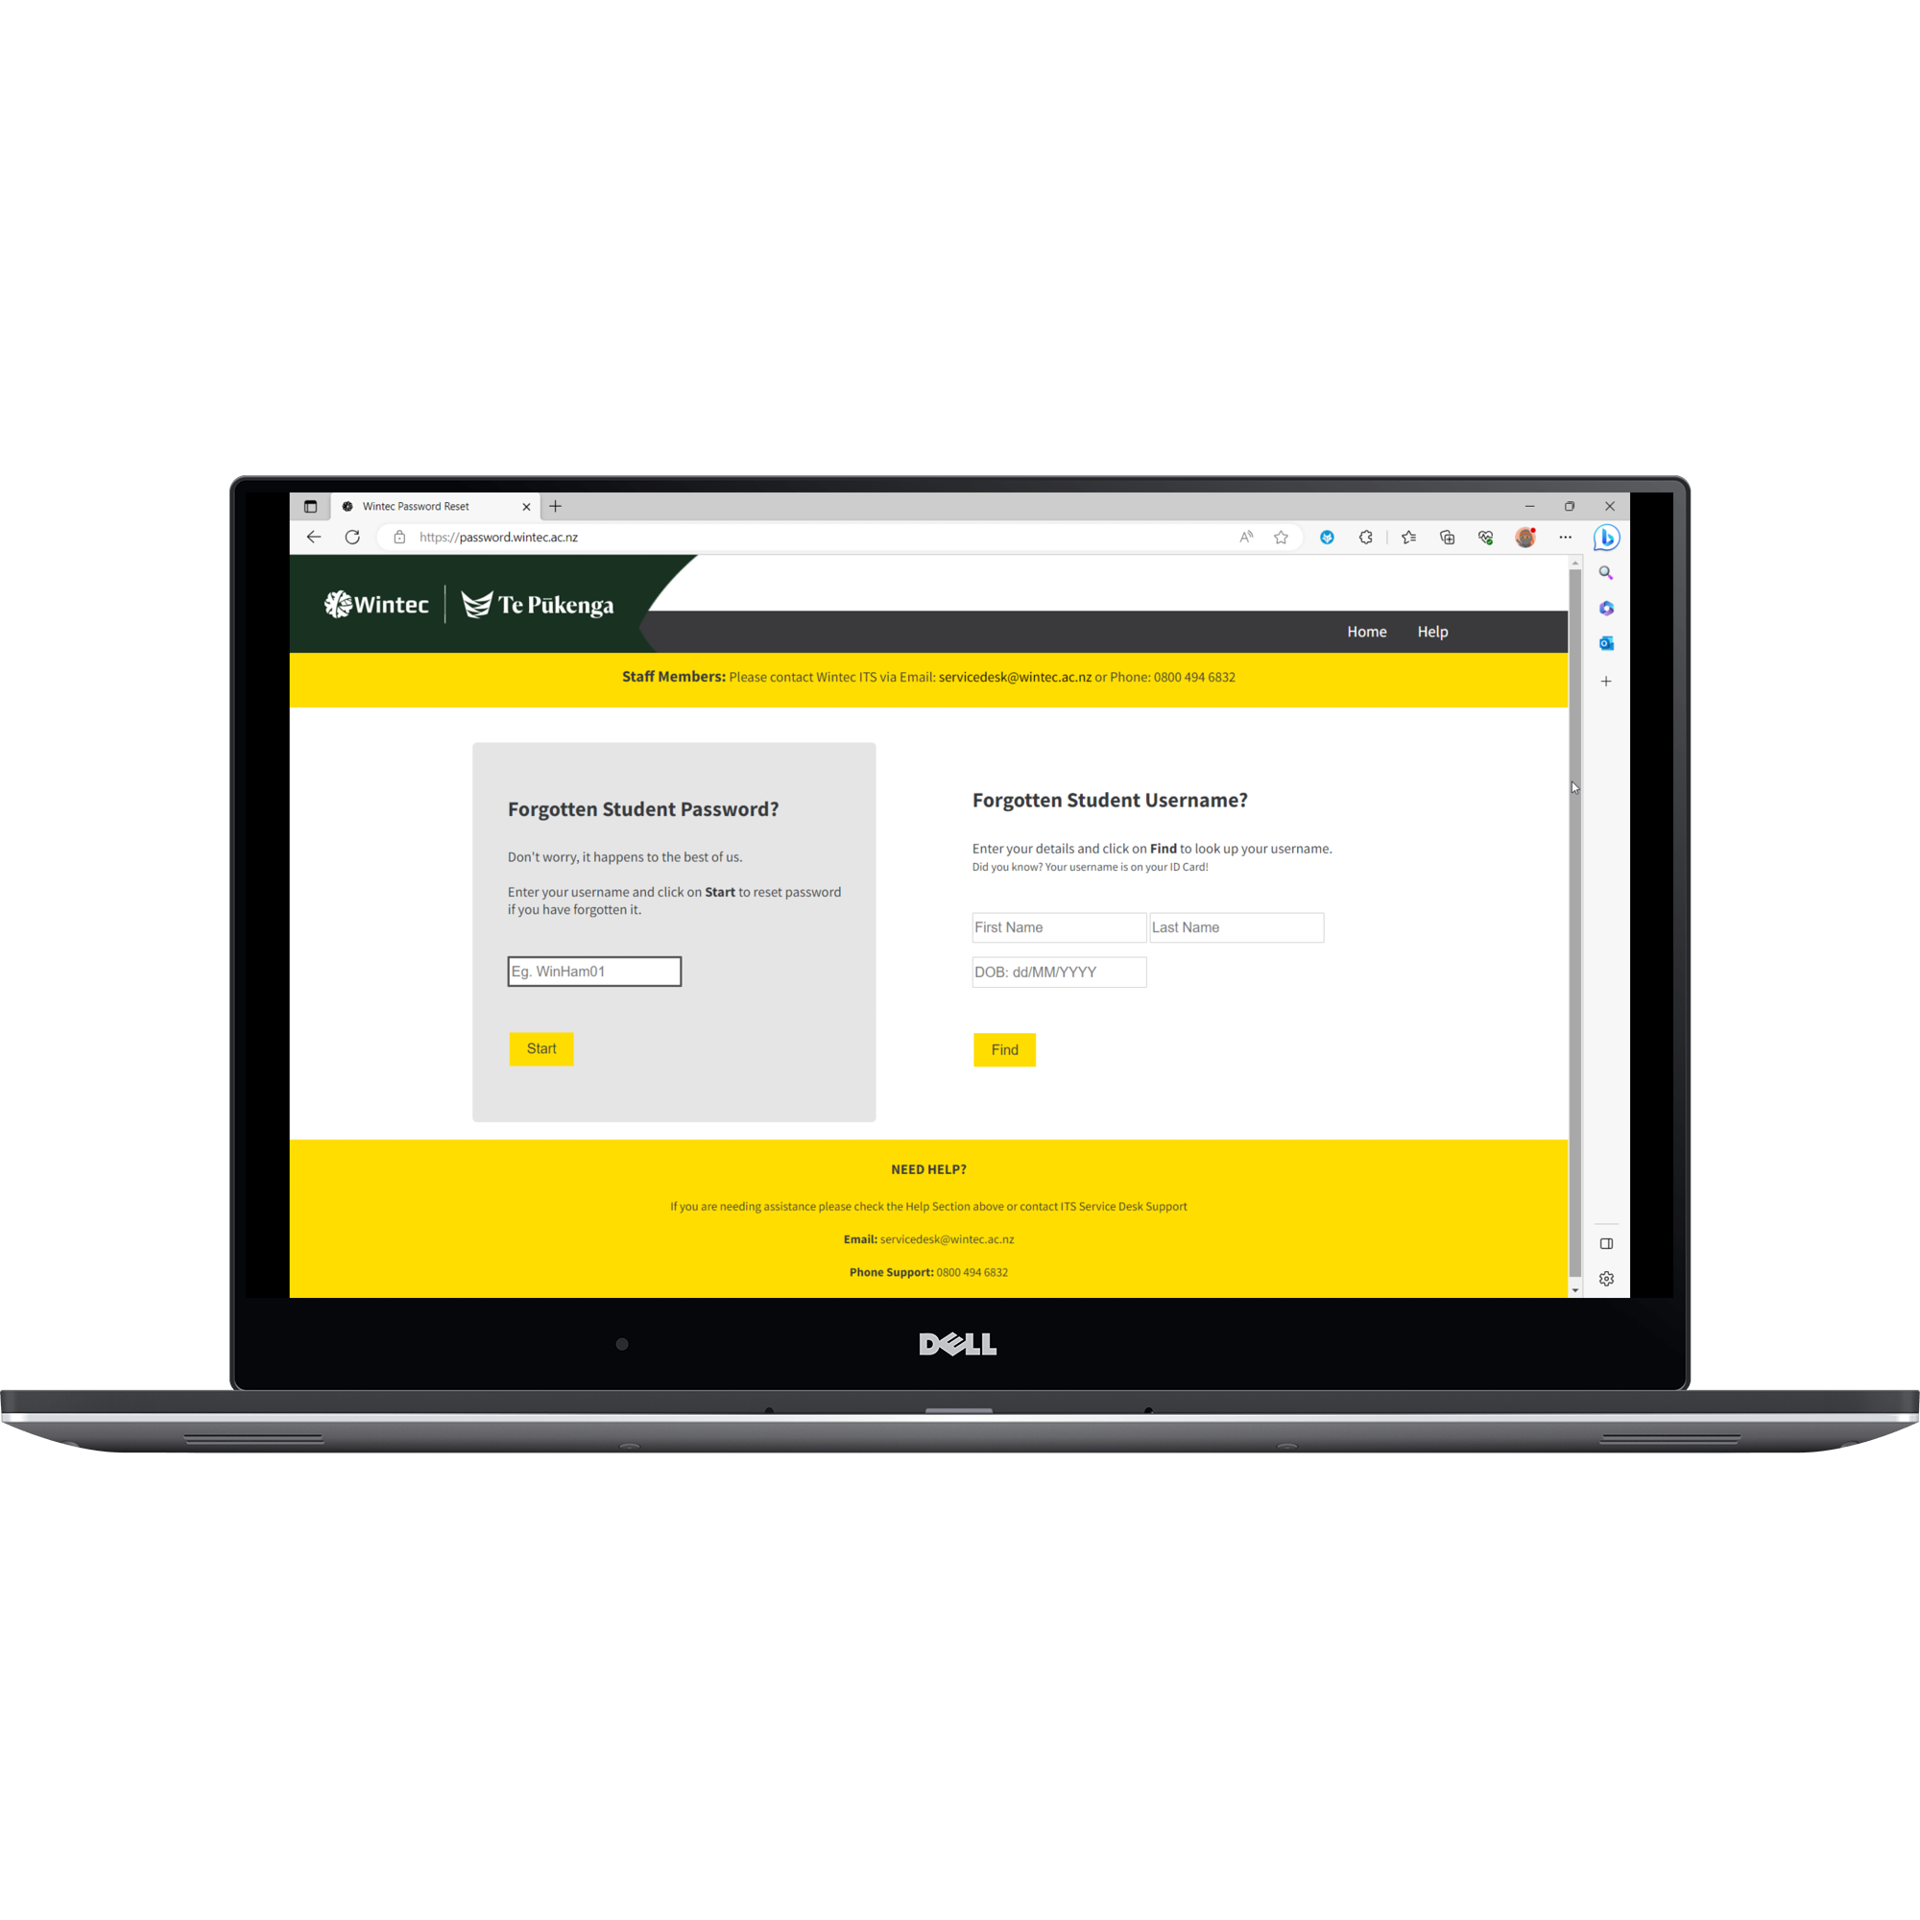
www.password.wintec.ac.nz
If you face any issues while changing your password, please contact us at servicedesk@wintec.ac.nz

Slide 4
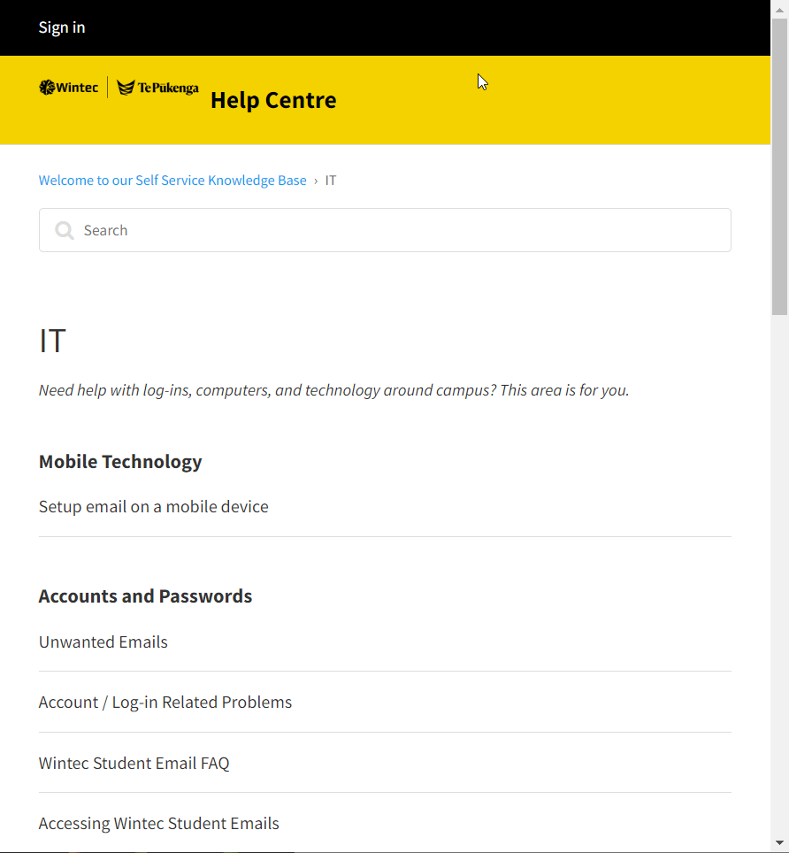
Your Account
Your Wintec email ID is your username followed by “@student.wintec.ac.nz”.
For example: usenam12@student.wintec.ac.nz

Slide 5
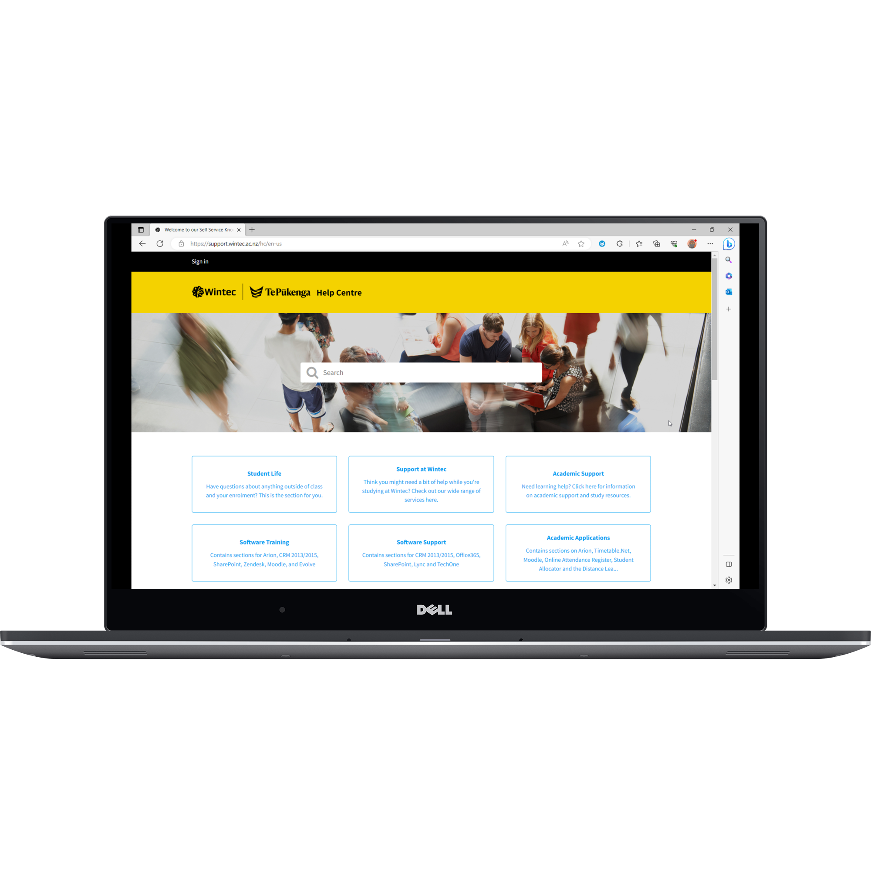
www.support.wintec.ac.nz Self Service Knowledge Base
Need help with IT, Academic Support, Enrolments, Student life and more?
Help Centre has articles with all the answers to your questions.

Slide 6
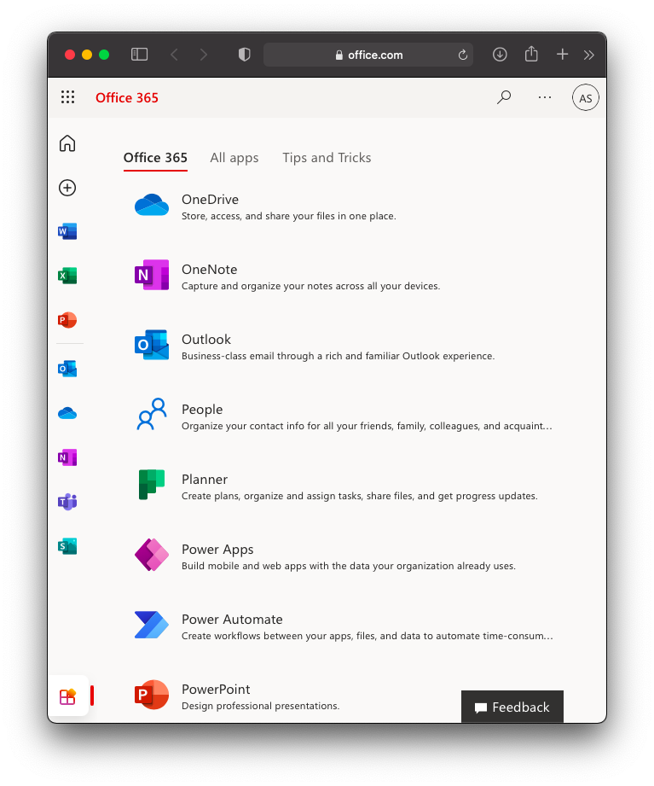
Microsoft Office 365
Download and install latest Office 365 applications like Word, Excel, PowerPoint and more.
Only available while you are a current student.
Self Service Knowledgebase > IT
Go to www.support.wintec.ac.nz and search for MS Office. Follow the instructions available.

Slide 7
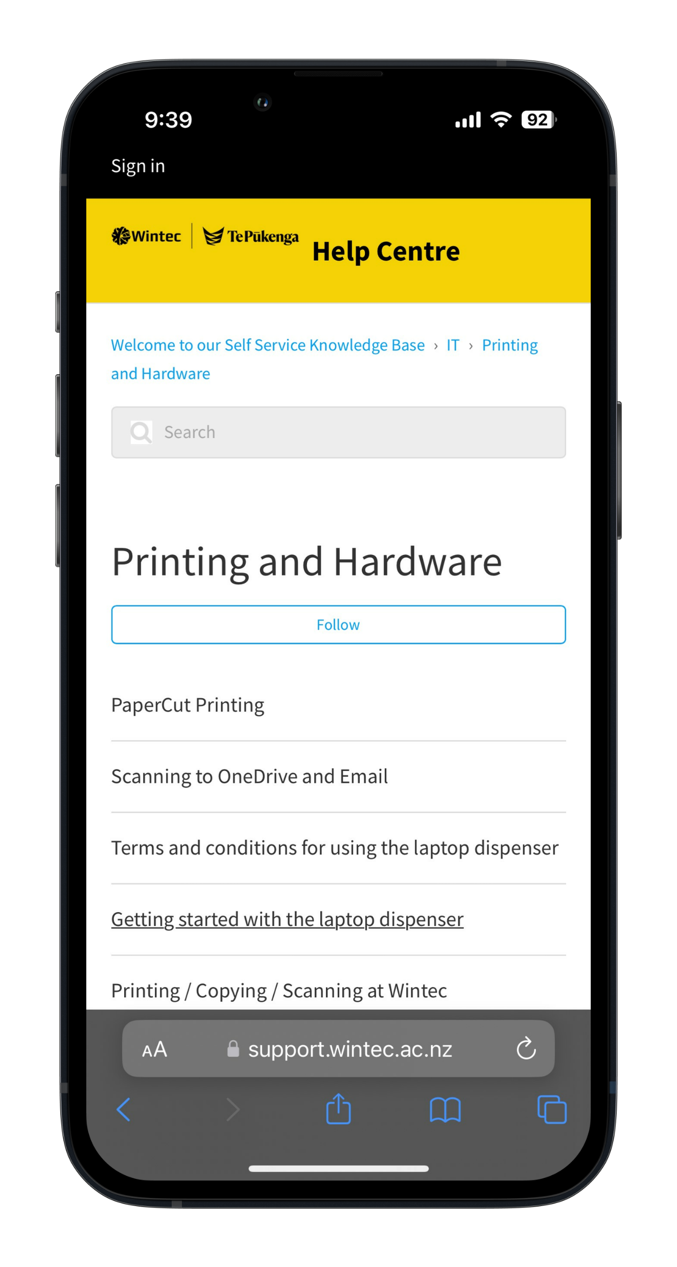
www.onlinetopup.wintec.ac.nz
Print
Copy
Scan
ONLINE PRINTING TOP-UP

Slide 8
Student Loan Laptops
Students can borrow a loan laptop for up to 4 hours per borrow.
Laptop dispenser is available at City and Rotokauri campuses.
Students need to setup a 4-digit pin on your ID card to use the laptop dispenser and you can get this setup from the Student Service desk.

Slide 9
Technology Use Policy
Promote Safe & Ethical IT use.
Respect the use of Hardware.
Prevent Unauthorized access
Report any suspicious breaches.
Use of only approved Wintec Applications

Slide 10
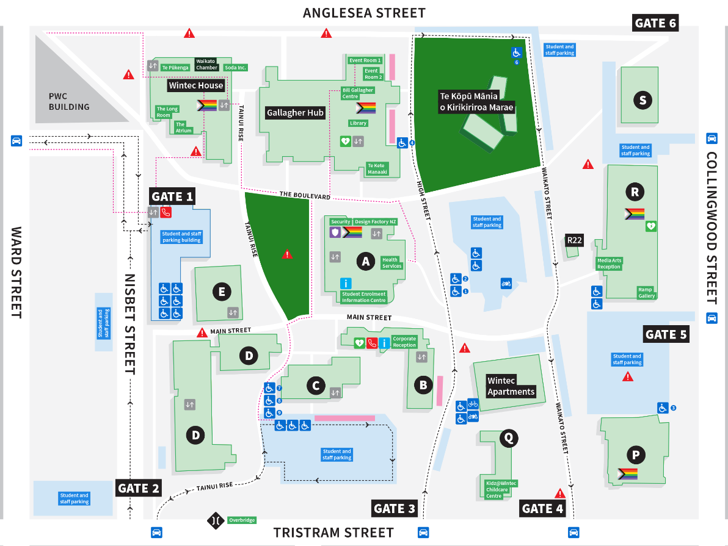
Where to find us
City Campus
Gallagher Hub
8:00 AM – 4:00 PM

Slide 11
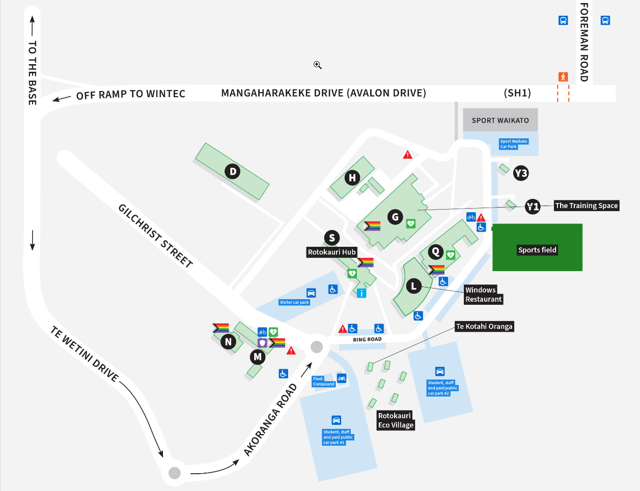
Where to find us
Rotokauri Campus
S Block – Hub
8:00 AM – 5:00 PM

Slide 12
Contact us
0800 4 WINTEC (0800 494 6832)
servicedesk@wintec.ac.nz
OPEN HOURS
Monday to Friday
8:00 AM – 5:00 PM

